Slide 1
Association Rules
Market Basket Analysis

Slide 2
Association Rules
Unsupervised learning
Descriptive and not predictive
Used to discover interesting relationships hidden in a large dataset.
Commonly used for mining transactions in databases
Possible questions to answer:
Which products tend to be purchased together?
Of those customers who are similar to this person, what products do they tend to buy?
Of those customers who have purchased this product, what other similar products do they tend to view or purchase?
Example:
Walmart: Beer and diapers bought together. Why might that be?

Slide 3
Terms and First Association Rule
https://www.youtube.com/watch?v=N5WurXNec7E
People who bought olives also bought chardonnay
Antecedent: olives
Consequent: chardonnay
{Olives} {Chardonnay}
78% of people who bought chardonnay also bought What to Do When He’s Not That Into You
{Chardonnay} {What to Do}
More Terms
Support (percent of customers who bought item, say olives)
Confidence (percent of customers who bought antecedent and also bought consequent)

Slide 4
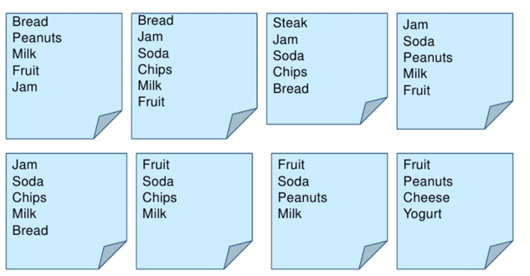
Example: 8 Market Basket Transactions

Slide 5
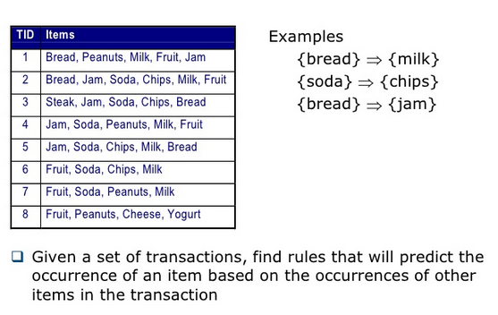
What is association rule mining?

Slide 6
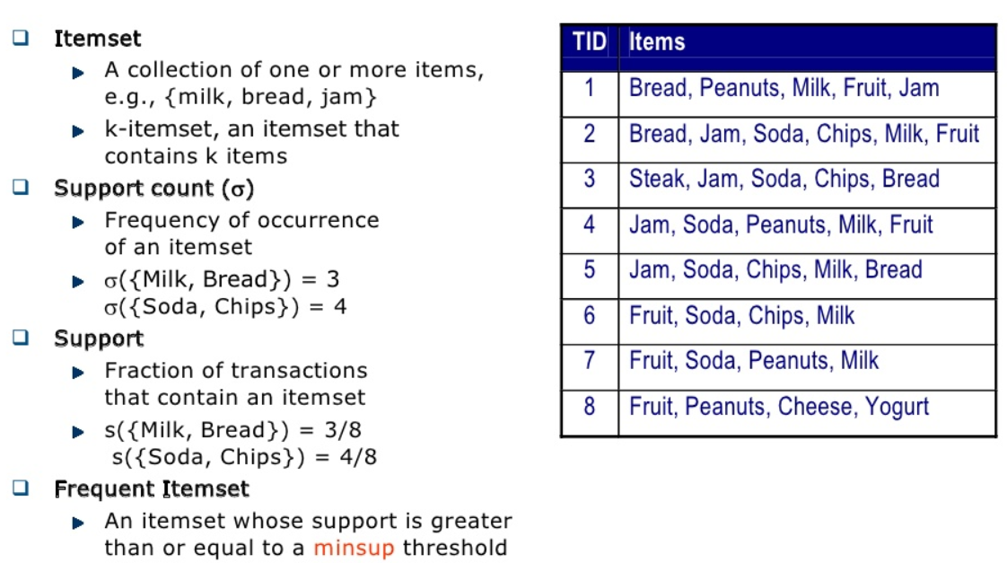
Definition of frequent itemset
3-itemset
TIDs: 1,2, 5
TIDs: 2,3,5,6

Slide 7
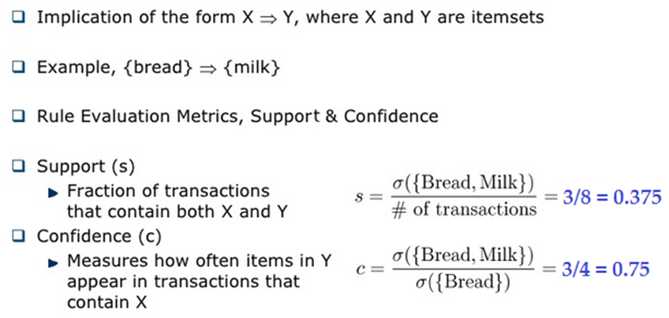
What is an association rule?
Proportion of bread-purchasing customers
who also bought milk.

Slide 8
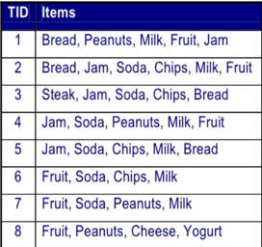
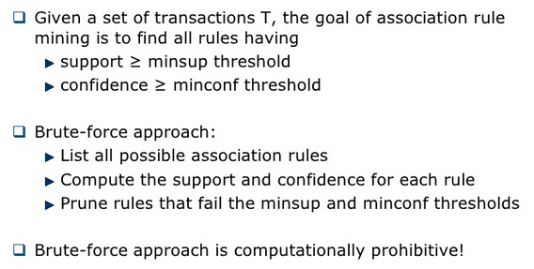
What is the goal?
Frequent itemset
Interesting relationship

Slide 9
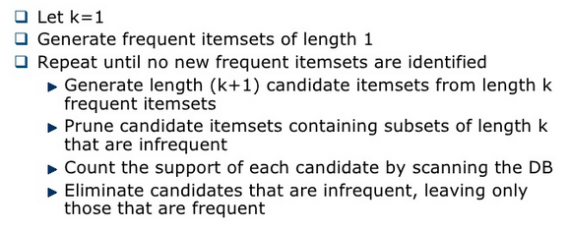
Apriori Algorithm

Slide 10
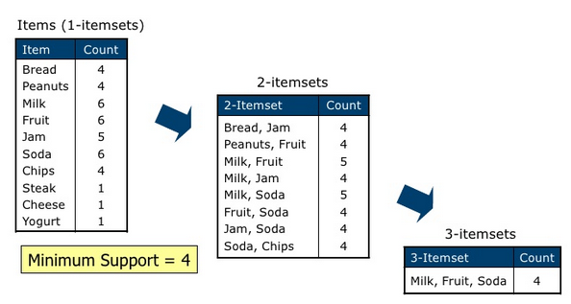

How does the Apriori principle work?
(.4)(8) = 3.2
Bread is out
Peanuts is out
{Milk, Fruit, Soda} –Soda with Milk, Fruit.
{Milk, Jam, Soda} TID 2, 4, 5
{Bread,Peanuts} TID: 1
{Bread,Milk} TID: 1, 2, 5
{Bread, Fruit} TID: 1, 2
{Bread, Jam} TID: 1, 2, 3, 5
{Bread, Soda}, {Bread, Chips} did not make cut

Slide 11
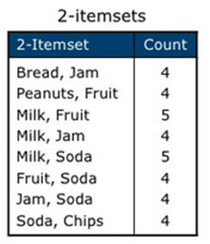
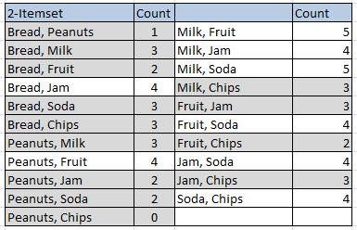
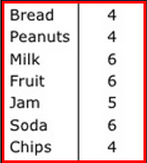
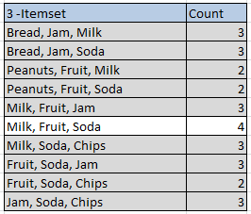
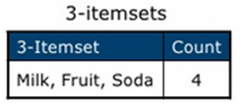

1-itemsets
that meet
minsup = 4
21 2-itemsets
Next, make 3-itemsets
from 2-itemsets
C(7,2) = 21

Slide 12
Forming Association Rules
{Milk} {Fruit}
Support: 5/8 = 0.625; Confidence = 5/6 = 0.833
{Milk, Fruit} {Soda}
Support: 4/8 = 0.5; Confidence = 4/5 = 0.80

Slide 13




Measures

Slide 14


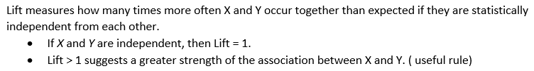
Lift and Leverage

Slide 15
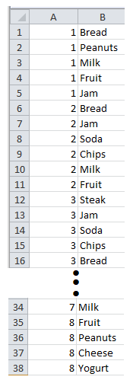
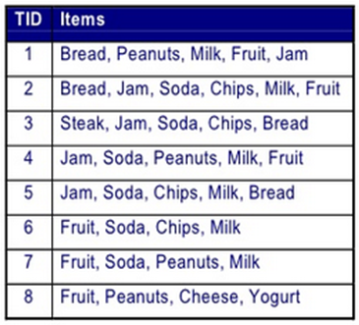
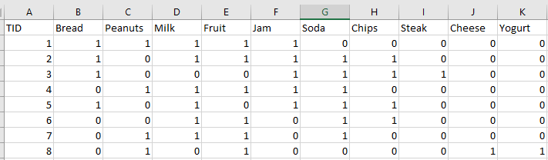
Entering Data:
Relational Format Compact Format Sparce matrix
<TID, itemset> <TID, item>

Slide 16
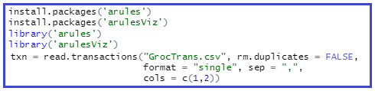
Using R
Start by exploring our small list of grocery transactions: Stored in relational format as GrocTrans.csv.
Install packages “arules” and “arulesViz”
Set working directory, read in the dataset – but transform it into sparce format:

Slide 17
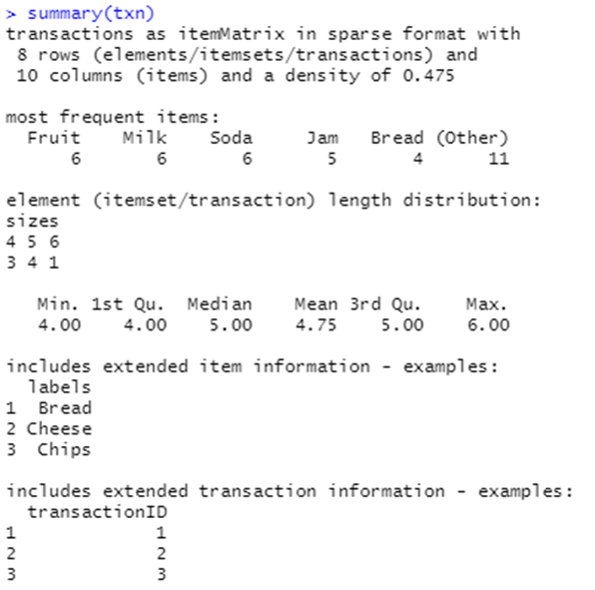

Slide 18
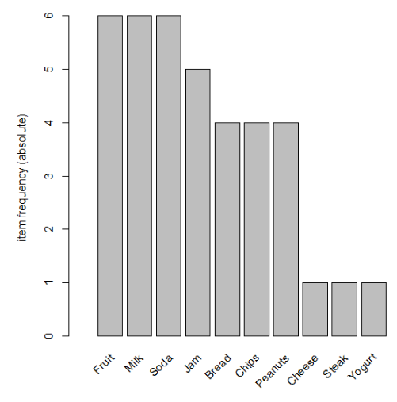

Slide 19
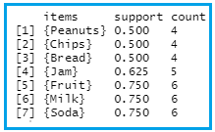
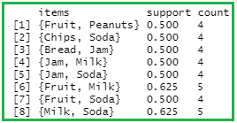

Creating k-itemsets

Slide 20
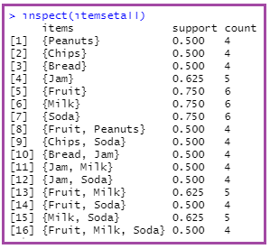
Getting all itemsets with support above minsup

Slide 21
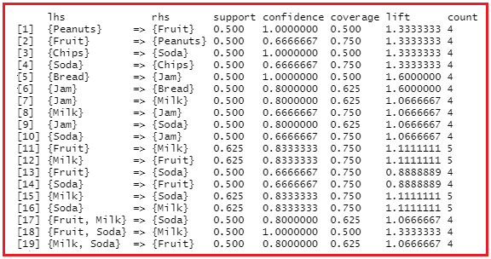
Association Rules

Slide 22

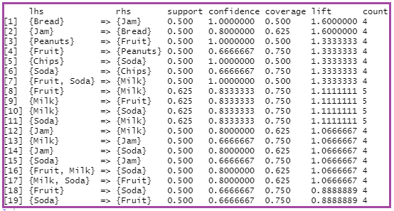
Sort rules by lift

Slide 23
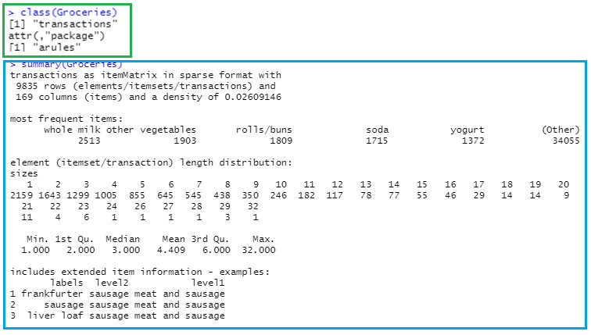

Data(Groceries)

Slide 24
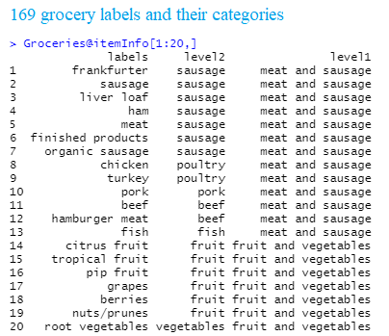

Slide 25
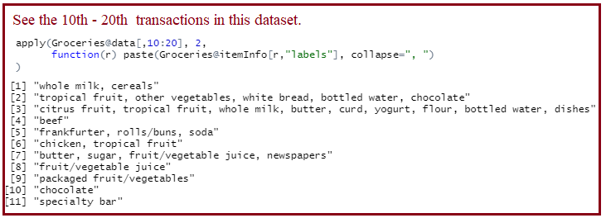

Slide 26

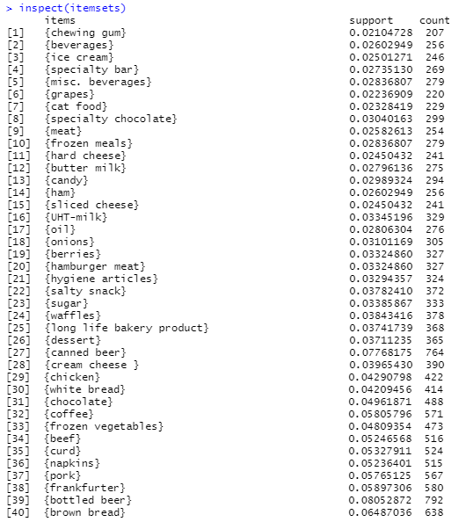
supmin = 0.02 based on management’s suggestion
Out of 9853 transactions, frequent itemset should
appear on at least 198 transactions.
Could sort by support; could select just the top 10.

Slide 27
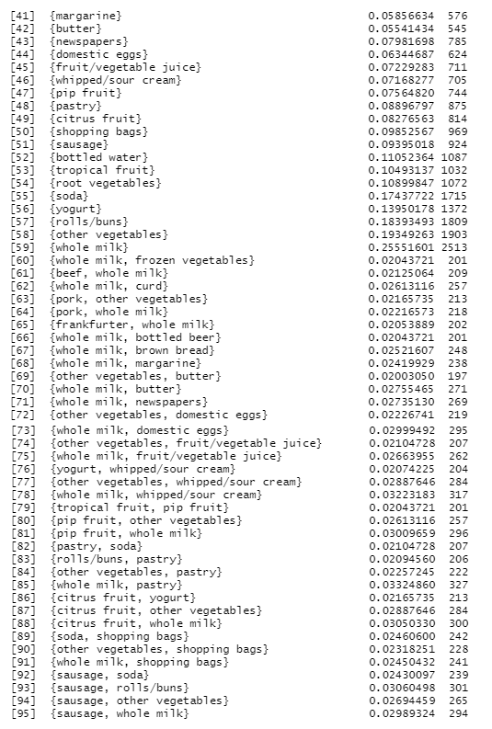
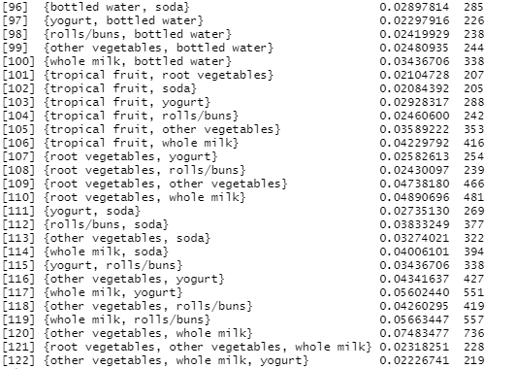

Slide 28
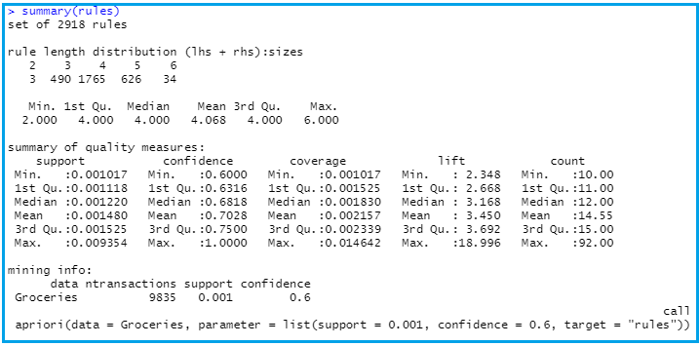

Slide 29
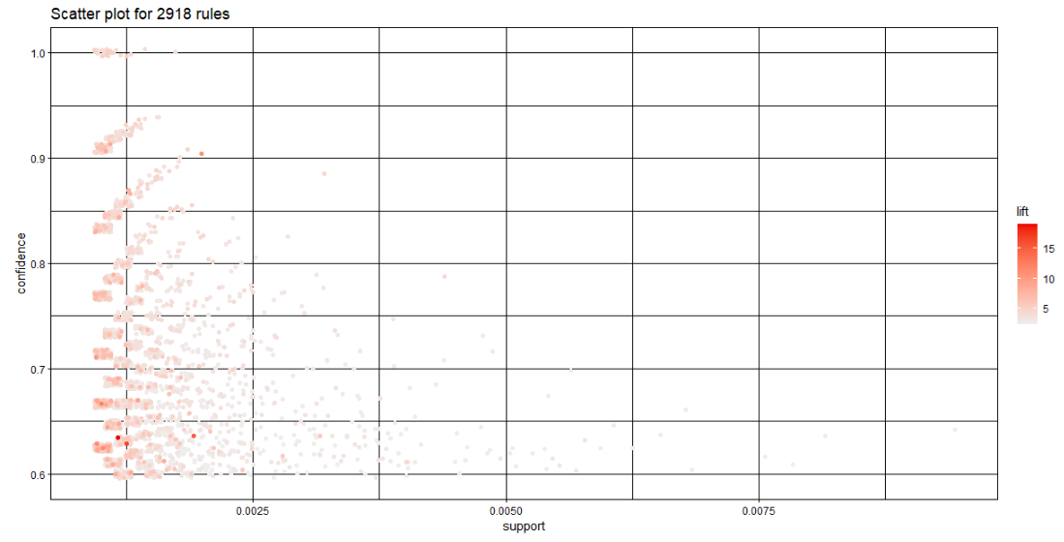
Highest lift occurs at low support and low confidence

Slide 30
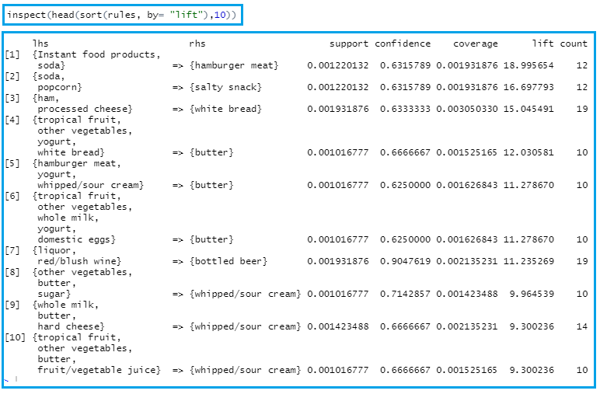

Slide 31
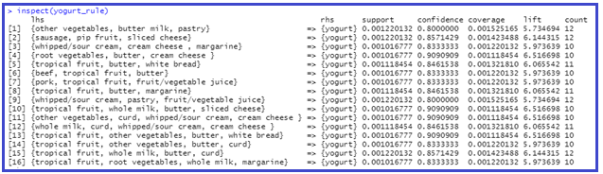
Analyze itemsets (lhs)in rules before yogurt (rhs)

Slide 32

Analyze {soda} (lhs) in rules to see what else likely in basket (rhs)
Rule [1] with empty lhs means that no matter what other items are involved, the item in rhs will
appear with probability given by the rule’s confidence. Fix by adding minlen = 2 to command (as was done
in the yogurt rule in previous slide.

Slide 33
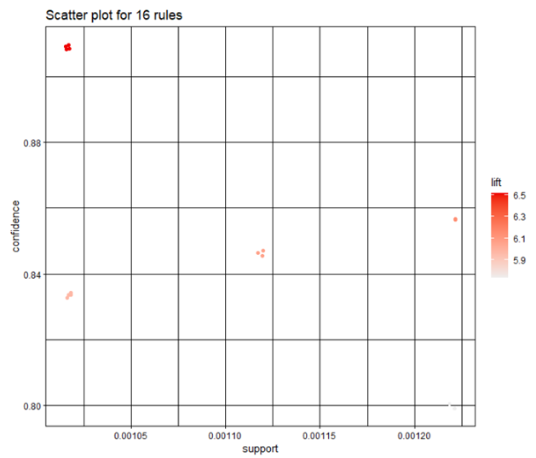

Visualizing rules
Return to the 16 yogurt rules

Slide 34
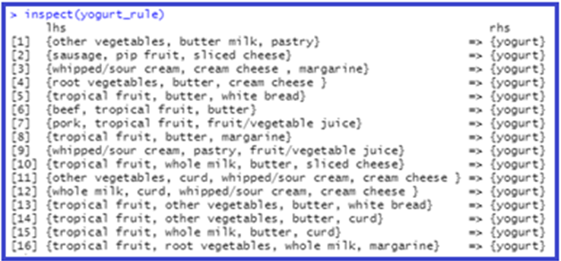
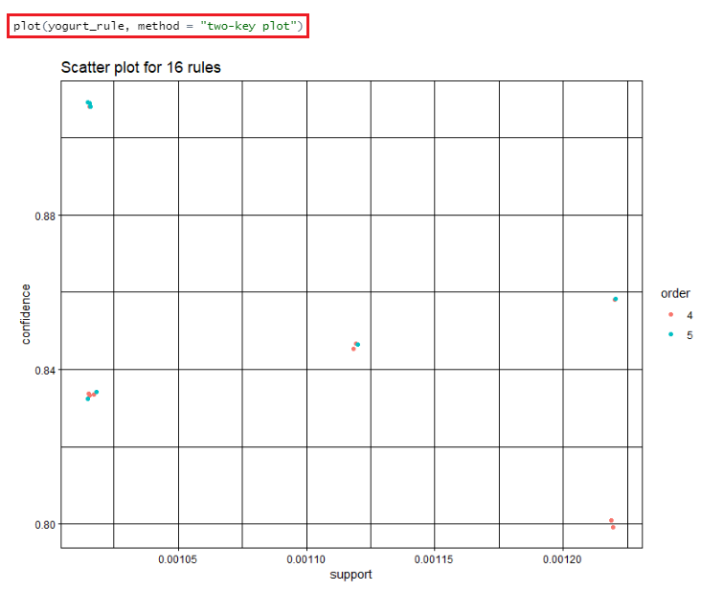

Slide 35

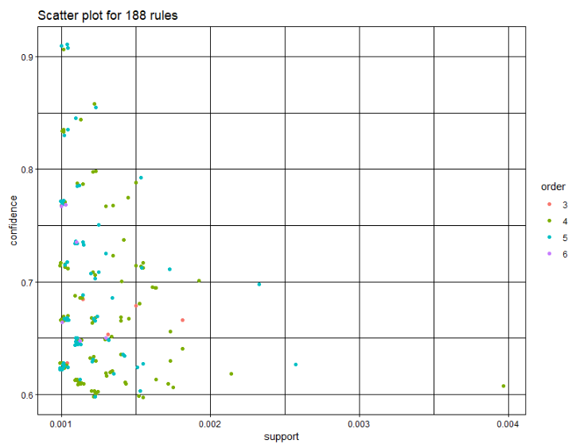
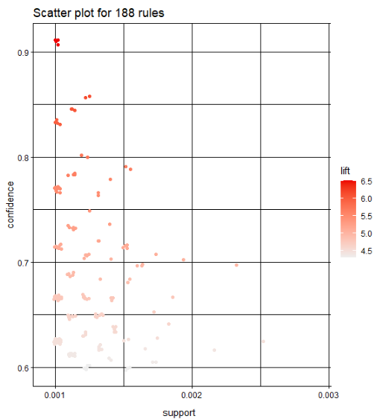

Slide 36
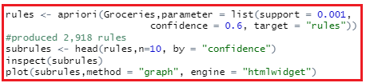
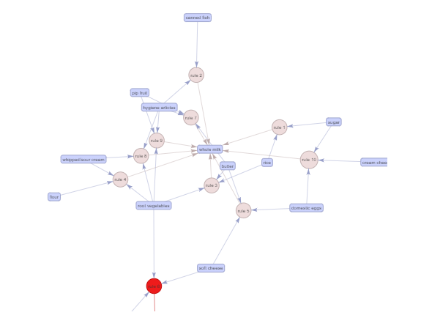

Slide 37

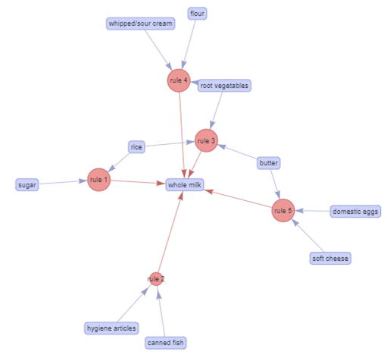


Slide 38

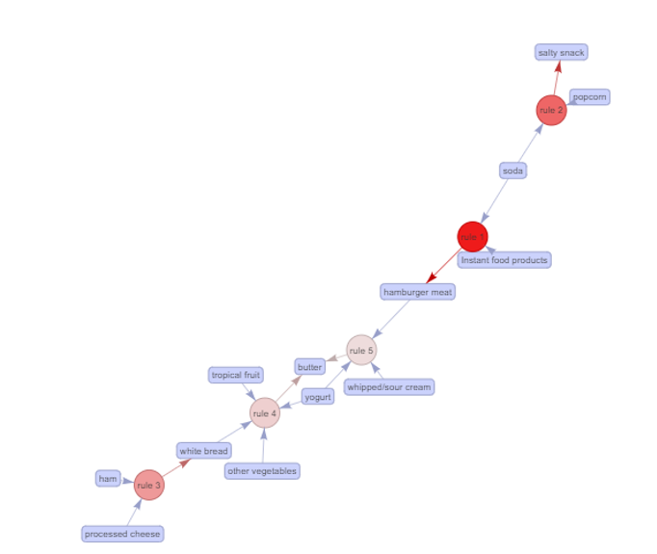

Slide 39


